Slide 1

AAT TECH-TALK
BEE
(AEEC01)
Roll No: 21951A66A9
Presenter name: RISHIKESH PRADHAN
Branch: CSE (AI & ML)

Slide 2
COMMUTATION OF
DC MOTORS
TOPIC NAME:

Slide 3



OVERVIEW
Definition of Commutator and Construction of a Commutator:
An introduction to Electric Motors
What Is the Commutation Process?
How Does a Commutator Work?
What Is a Commutator Motor?
Features and Disadvantages of Commutator Motors
Working Principle Of DC Motor
Conclusion

Slide 4




Introduction
Today in this presentation, I am going to explain one of the most important revolutionary components used in electric motors that brought new features. A commutator is the device we are going to elaborate on. In the following sections, we show you how commutator motors work and what features they bring to our lives.

Slide 5

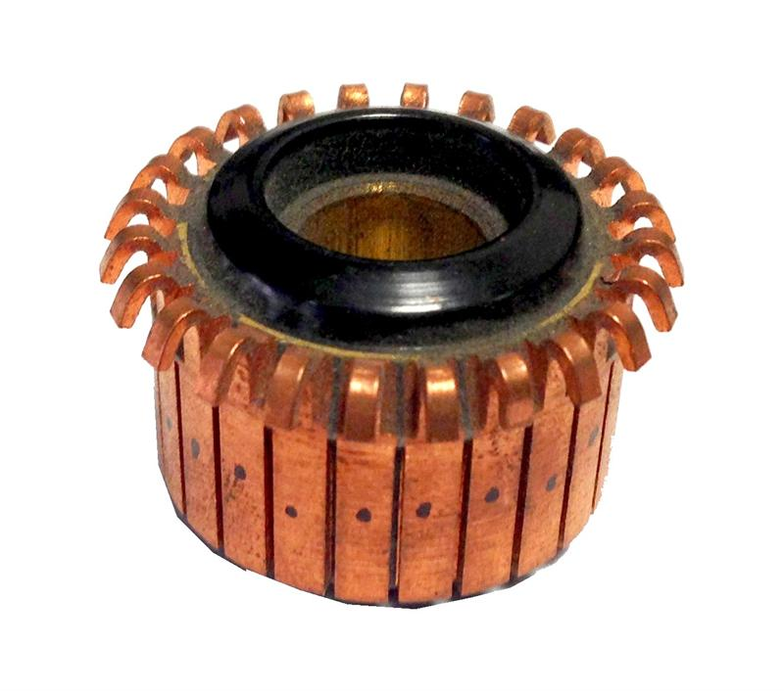
Definition of Commutator and Construction of a Commutator:
Definition of Commutator:
A commutator is a rotary electrical switch that periodically reverses the direction of the current between the rotor and the external circuit.
Construction of a Commutator:
A commutator is built with a set of contact bars and is set into the revolving shaft of a DC machine allied to the armature winding.
The commutator reverses the current flow within a winding when the shaft turns. Once the shaft completes a half-turn, the windings are connected so that current supplies through it in the reverse of the first direction.
In a DC motor, the magnetic field uses a rotating force or a torque over to the winding to rotate. On the other hand, in a DC generator, mechanical torque is applied in the direction of the shaft to maintain the armature winding motion. In both cases, commutators reverse the direction of current flow throughout the winding. The flow of current within the circuit that is external to the machine is in a single direction.

Slide 6
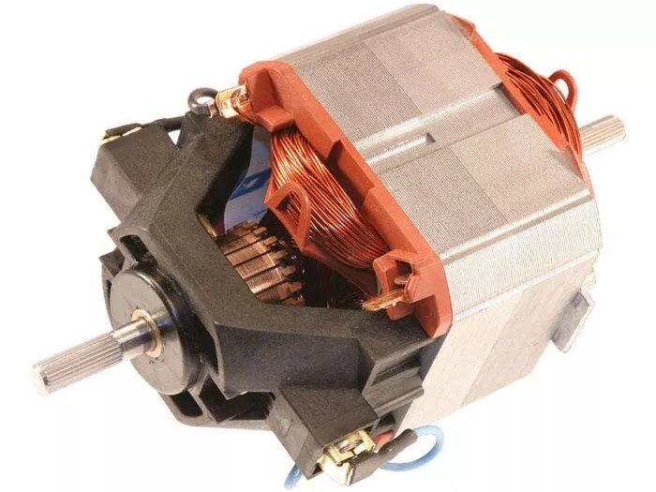
An introduction to Electric Motors
As you may know, Electric motors are devices that convert electrical energy to mechanical energy. They usually do this by employing electromagnetic phenomena. The interaction of conductors carrying current in a direction at right angles to a magnetic field is what brings mechanical torque in electric motors. The different kinds of electric motors are distinguished by the ways in which the conductors and the field are arranged and also in the control that can be exercised over mechanical output torque, speed, and position.
Most of the types were explained before on the website and you can reach them with a simple search. As we mentioned before, we intend to talk about the commutator motors in this article. But what we need to reach this point is to see what a commutator is and how it works.

Slide 7
What Is the Commutation Process?
So far, we know that how generally and based on what main rule electric motors work. In this section and in order to better understand the performance and features of commutator motors, we intend to get acquainted with its main component i.e. the commutator.
As you may know, The operating principle of DC motors is on the basis of the mutual interaction between the magnetic field of an armature rotating and the magnetic field of a fixed stator. when the armature’s north pole is attracted to the stator’s south pole or vice-versa, a force is produced on the armature causing it to rotate. Commutation is indeed the process of switching the field in the armature windings to make constant torque in one direction with the purpose of ensuring that the torque acting on the armature is always in the same direction and the device connected to the armature enabling this current switch is the commutator.

Slide 8
How Does a Commutator Work?
A commutator itself is a split rotary ring, typically made of copper, with each segment of the ring attached to each end of the armature coil that is used in some types of electric motors and electrical generators whose job is to periodically reverse the current direction between the rotor and the external circuit. The armature having multiple coils need a commutator with similarly multiple segments supporting each end of each coil. Spring-loaded brushes are put on each side of the commutator and make contact with it as the commutator turns and supplying the commutator segments and the corresponding armature coils with voltage.

Slide 9
How Does a Commutator Work?
Commutators are mostly applied in direct current machines such as dynamos or as they are called DC generators and many DC motors as well as universal motors. By reversing the current direction in the rotating windings each half turn, a steady rotating force which is called torque is produced. In a generator the commutator picks off the current generated in the windings, reversing the direction of the current with each half turn, serving as a mechanical rectifier to convert the alternating current from the windings to unidirectional direct current in the external load circuit. The first DC commutator machine, the dynamo, was built by Hippolyte Pixii in 1832.

Slide 10
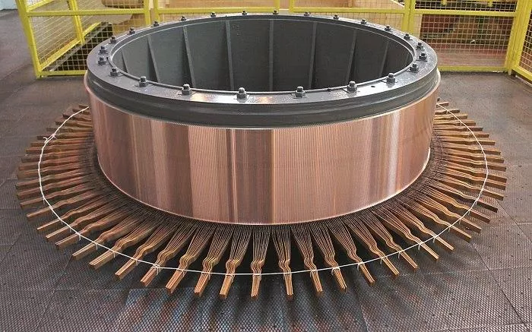
How Does a Commutator Work?
We have to note that what we discussed above relates to traditional brushed DC motors with a traditional commutation process that uses mechanical means. Brushless DC motors also need a commutation process, but the difference is that for brushless designs the commutation process is carried out electronically, via an encoder or hall effect sensors monitoring the position of the rotor to determine when and how to energize the coils in the armature.

Slide 11
What Is a Commutator Motor?
The basic form of almost all the direct-current motor is the same. A stationary magnetic field is made across the rotor by set poles on the stator. The coils carrying direct current encircle these poles or they may contain permanent magnets. The armature or as it is called the rotor consists of an iron core with a coil accommodated in slots. Almost all the DC motors whose ends of the rotor coil are connected to the bars of a commutator switch mounted on the rotor shaft are called commutator motors.
Suppose the armature terminals connected to a direct-current supply in a wat that a current enters at the positive terminal. The interaction between this current and the magnetic flux produces a counterclockwise torque accelerating the rotor. The commutator enters when the rotor has turned about 120°, and reverse the connection from the supply to the armature.

Slide 12
What Is a Commutator Motor?
The new direction of the current in the armature coil is such as to continue to make counterclockwise torque while the coil is under the pole. Proportional to the speed, a voltage is generated in the armature coil. As this coil voltage is alternating, the commutation process makes a unidirectional voltage at the motor terminals. The electrical input will be the product of this terminal voltage and the input current. The mechanical output power will be the product of the rotor torque and speed.

Slide 13
Features and Disadvantages of Commutator Motors
In the previous sections, we get acquainted with the commutation process and how a commutator works. Here and in this section, we list some of the features and disadvantages of the commutator motors.
The following are some of the features that Commutator motors offer to us:
They can be used with 100 VAC for home appliances
They can Rotate faster than induction motors
under increased load, the rotating speed goes down, and torque increases
Startup torque is large
They provide high output
They are lightweight motors

Slide 14
Features and Disadvantages of Commutator Motors
Because of these characteristics, the commutator motors are used for home appliances such as electric vacuum cleaners and some other tools such as electric drills that require high-output, lightweight motors. some other devices such as mixers and coffee mills requiring rotations faster than induction motors, use commutator motors as the driving force.
On the other hand, the commutator motors have some disadvantages that we listed some of them below:
They Generate loud noises
Due to the service life of their brushes, these motors are not suited for constant or continuous operation.

Slide 15
Working Principle Of DC Motor
In our daily lives, we come across a variety of battery-powered electrical gadgets that transform electrical energy into mechanical energy, such as hairdryers, toy vehicles, tiny fans, trimmers, and so on. The electrical component responsible for this action is a Direct Current (DC) motor present inside those gadgets.
A DC motor is a type of electric machine that converts electrical energy into mechanical energy. They take electrical power through direct current and convert this energy into mechanical rotation. Today, DC motors have become an integral part of the industrial sector and are used for various applications, such as electric vehicle propulsion, elevators, cranes, and steel rolling mill drives. In this article, we will discuss the working principle of DC motor. Follow this new blog in Linquip to find out more.

Slide 16
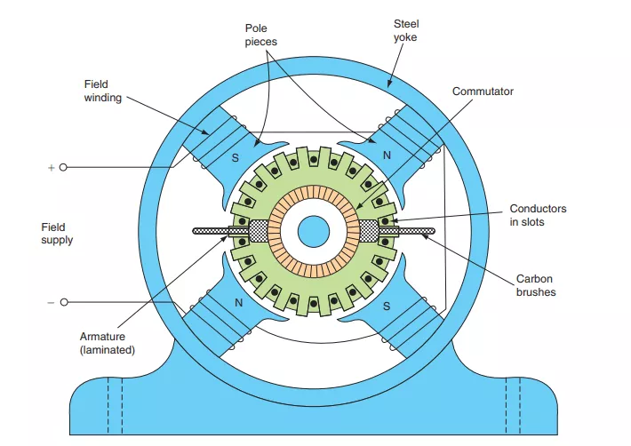
Working Principle Of DC Motor

Slide 17
DC Motor Components
To understand the working principle of DC motor, let’s first look at the components used in its construction. A DC motor usually looks like a cylindrical device with a shaft extending out of it that rotates on applying DC. This action is carried out by arranging the following components in a particular manner.
Stator
A stator, or a steel yoke, is a cylindrical metal casing inside which all the other elements of a DC motor are placed. One face of the stator contains a vertical shaft coming out of it, while the other face has the two terminals to which the DC power supply is connected.

Slide 18
DC Motor Components
Magnets
There are two stationary permanent magnets installed inside the stator of a DC motor. They act as the north and south poles of a magnet by setting up a horizontal magnetic field across them.
Armature
In electrical engineering, the term armature refers to a structure of rotating coils under the influence of electromagnetic force. In a DC motor, an armature is composed of a rotor placed between the two magnets. A rotor is a structure of laminated discs wrapped around by a conducting field coil. The shaft pointing out of the motor passes along the axis of the armature and rotates along with it.

Slide 19
DC Motor Components
Field Coil
The field coil or field winding in a DC motor is a coil of copper wires that replaces the permanent magnets attached to the inside walls of the stator. When DC from a battery is passed through this coil, it forms an electromagnet whose polarity can be controlled, setting up a desired magnetic field.
Commutator
A commutator is a hollow cylindrical piece segmented at many spots to reverse the polarity of the electromagnetic armature coil inside the DC motor. It is a critical part of a motor to work on a DC power supply. It sits at the end of the armature around the shaft. The ends of the armature coil are connected to the commutator, while all other parts, except brushes, are electrically isolated from it.

Slide 20
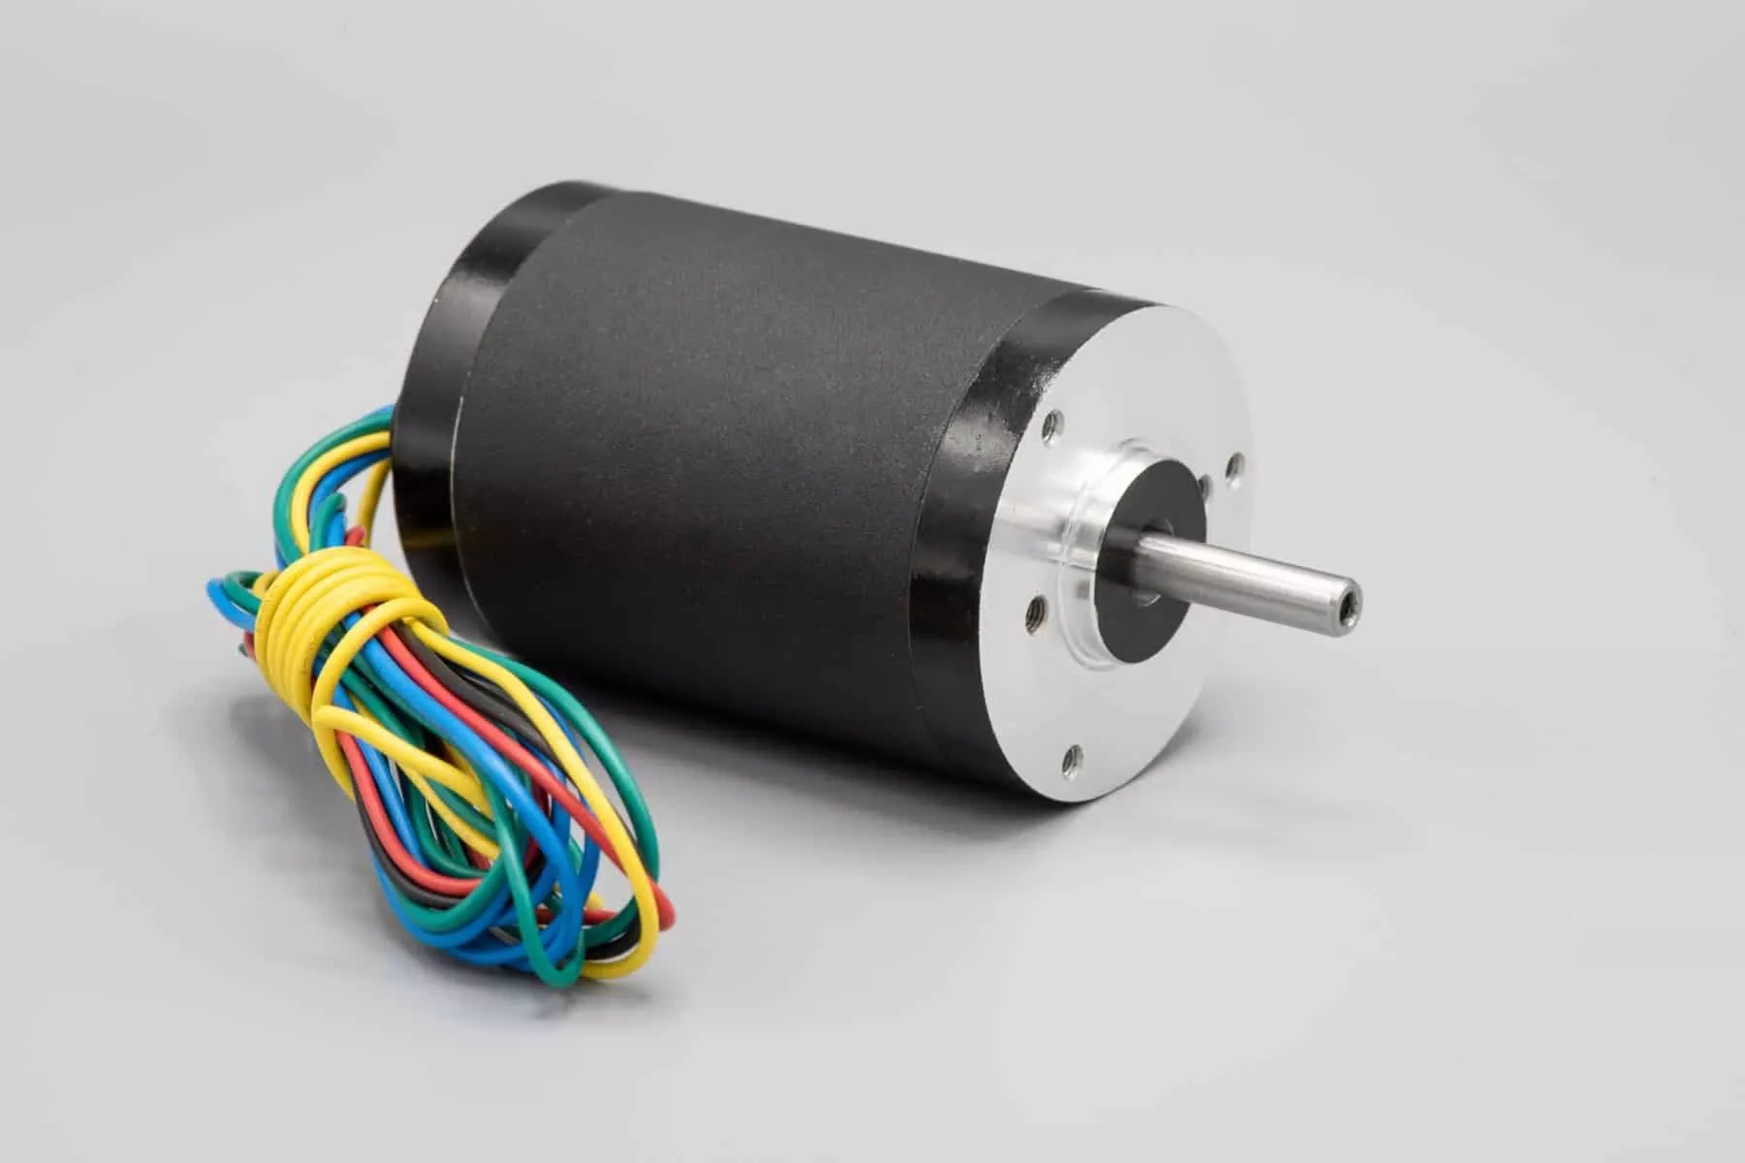
DC Motor Components
Brushes
The brushes in a DC motor are the components that connect the static terminals to the rotating parts of the motor. They are usually made of carbon graphite since it is a great conductor of electricity and have excellent lubricant properties. The commutator is positioned between the two brushes, which are further connected to the motor’s terminals, completing the circuit with the DC power source.

Slide 21
Working Principle Of DC Motor
A DC motor works on the principle that whenever a current-carrying conductor is placed inside a magnetic field, it experiences a magnetic force whose direction is given by Fleming’s Left-hand Rule. In other words, the DC motor spins due to the interaction of the permanent magnet’s magnetic field with the magnetic field of the current-carrying electromagnet.
Fleming’s Left-Hand Rule
Fleming’s Left-hand rule is a mnemonic tool to understand the mutually perpendicular relationship between the current, an applied magnetic field, and induced force in an electric motor. If we extend the index finger, middle finger, and the thumb of the left hand in mutually perpendicular directions, aligning the middle finger with the conventional direction of current inside the current and the index finger with the applied magnetic field, then the thumb gives the direction of the force experienced by the conductor.

Slide 22
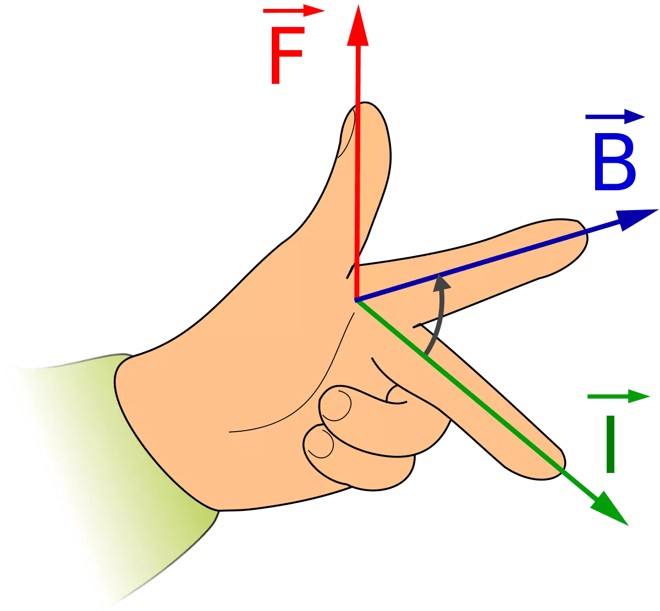
Working Principle Of DC Motor
F = BIL Newtons
Where,
B = magnetic flux density,
I = current and
L = length of the conductor within the magnetic field.
When armature winding is connected to a DC supply, an electric current sets up in the winding. Permanent magnets or field winding (electromagnetism) provide the magnetic field. In this case, current-carrying armature conductors experience a force due to the magnetic field, according to the principle stated above.

Slide 23
Working Principle Of DC Motor
To understand how this acts inside a DC motor, let’s discuss the working of a DC motor in more detail.
The working principle of DC motor requires magnetic flux and a current-carrying conductor. Consider a coil carrying DC current through commutator and brushes. These commutator segments rotate freely around their axis. The commutator segment which comes in contact with the left brush gets positive polarity while the right one gets negative polarity. This leads to the flow of current in the coil.
By applying Fleming’s Left-Hand Rule, the conductor on the left side always experiences a force in an upward direction while the conductor on the right side experiences a downward force. Hence, a unidirectional torque is achieved in dc motors.

Slide 24
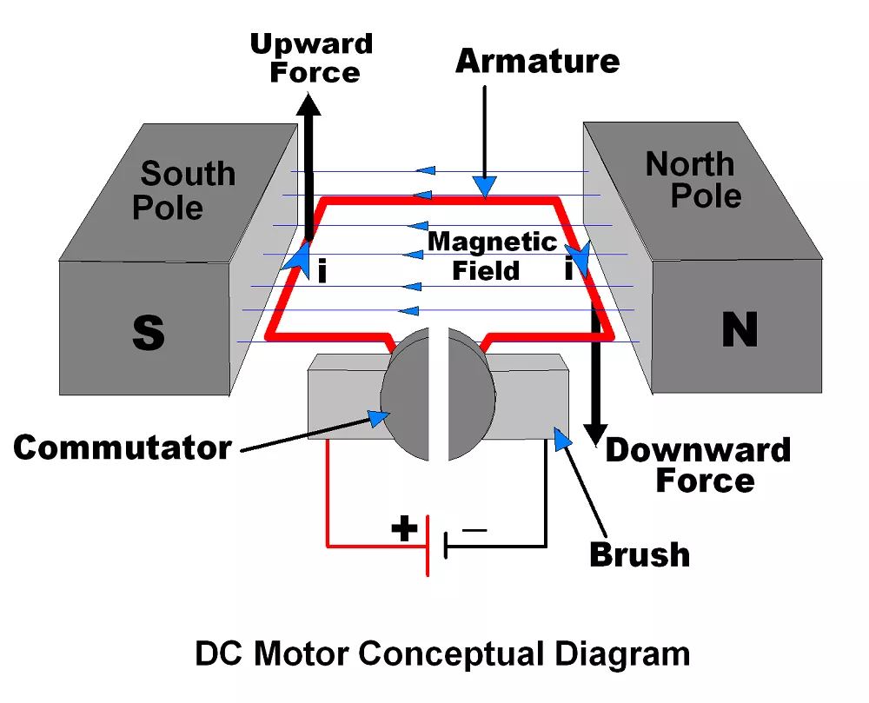
Working Principle Of DC Motor

Slide 25
Working Principle Of DC Motor
Back EMF
The interaction of the current-carrying conductor with the changing magnetic field produced by the field winding induces an EMF in the conductor. This EMF acts in the opposite direction to the applied voltage. This induced EMF in the motor is known as Back EMF.
The magnitude of back EMF is directly proportional to the speed of the motor. Consider the load on a dc motor is suddenly reduced. In this case, the required torque will be small as compared to the current torque. The speed of the motor will start increasing due to the excess torque. Hence, being proportional to the speed, the magnitude of the back EMF will also increase. With increasing back EMFarmature current will start decreasing. With the torque being proportional to the armature current, it will also decrease until it becomes sufficient for the load. Thus, the speed of the motor will regulate.

Slide 26
Working Principle Of DC Motor
On the other hand, if a dc motor is suddenly loaded, the load will cause a decrease in the speed. Due to a decrease in speed, the back EMFwill also decreases which allows more armature current. Due to an increase in armature current, the torque will increase to fulfill the load requirement.

Slide 27

Conclusion
In this presentation, I tried to give you essential and comprehensive information about the commutation process, commutator, and most importantly, the commutator motors. I discussed about the design and construction of commutators and the vital role in most of the DC motors. Besides, for better understanding, I brought some basic pieces of information about the working principle of electric motors. In the end, I listed some of the features and disadvantages of this type of motor for you and mentioned where this type of motor is commonly used.

Slide 28


Thank You
Roll No: 21951A66A9
Presenter name: RISHIKESH PRADHAN
Branch: CSE (AI & ML)

